Slide 1
IGCSE Art 1
Cambridge course First days of school

Slide 2
Welcome back!
We have lots to do and little time to do it in!

Slide 3
Classroom rules
Every person in this room has value and is to be treated with respect.
Everyone’s work is treated with respect. Any form of disrespect will be dealt with to the full extent of the school policy.
You must put everything away that you took out or were using during class in order to leave.
There is a daily drawing for the first 10 minutes of each class.
All photographs or first hand sources are due on the Sunday before a project is due in the google drive (more on this in later slides)
No Gum, No food, No exceptions.
Everyday operation and tasks

Slide 4
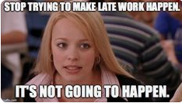
Late work
All late work is subject to receiving 5 points deducted due to it being late.
Any non-Cambridge course work that is later than two weeks will not be taken. (Notebook checks, weekly sketches and artist sheets, weekly quizzes)
Late work will only be taken with a late worksheet, Students also must stay after class for a chat on due dates.
Extensions will only be issued to students who have a written doctor’s note or have been out for longer than a week for other issues that have been communicated with the teacher.

Slide 5
Cell phones
There is a zero cell phone policy in my room.
If I see it, its mine for the end of the class. If its out again being taken to the front office and your parents will need to come pick it up. If its out a third time you will no longer be able to have it during classes and it will be a discussion with Mr. De Alba.

Slide 6
Assigned Seating
All students are to be in their seats before class starts.
You are expected to come to class ready to learn and work. So make sure you have everything you need for class before you sit down.
You won’t always get to sit next to your friends because you have to learn how to get along with everyone and learn how to work with people you don’t always hang out with or like.

Slide 7
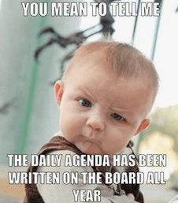
Listening to all directions
Art is done with steps and is a process. You have to make sure you are listening to all steps and taking all of them to create what you were hoping for.
Making sure you are taking notes and asking questions that are helpful to learning.
Ask 3 before me. If you are not sure of something, always ask. But if you are unsure of what I just said or weren’t paying attention ask a table mate.
All directions and due dates are always written on the board

Slide 8
Eating during class
There is no food allowed in here for a few reasons. We are in an Art classroom, there is art supplies everywhere and although they will not harm you if they get on you, you really don’t want to eat or drink them in.
The other reason should be a no brainer, you don’t want food on your art work. I have had so many projects ruined because someone dripped something on their work or someone spilled what ever they where drinking all over the table. To avoid all of this we do not want to eat food and limit liquids to water.
If you are chewing gum you will be asked to spit it out. Its in the handbook, that you signed, so just spit it out and if you truly need to have fresh breath or chewing helps you concentrate I will give you a mint or a hard candy. If this becomes an issue detention will be assigned.

Slide 9
Cambridge Course.
IGCSE Art and Design is a Cambridge course and we will be taking a test at the end of the year.
This year students who are interested or showing expert skill in art will be encouraged to take AS Art 1 next year and will make a paper portfolio, students who wish to take other classes like ceramics, photography, dance, drama, or one of the music classes will create a digital portfolio with their work. Both portfolios will look the same one will just be a physical form.
Students wishing to have an honors credit attached to their transcript will have to one of the following, take and pass the exam or take do the extension assignment. If you are interested please let me know and I will go over it. If you wish to just take the class and enjoy the art making process there is nothing wrong with that.
Doing the bare minimum will only get you the bare minimum to pass and that will drag your GPA down significantly. (That would be a 60% which is a D). Students who go above and beyond will earn the highest marks.

Slide 10
Tool check out
Art tool are able to be checked out. But if they are not returned and email home and a conference will be set up. Most tools in here I have purchased to replace something that has either been destroyed or used to the end of its life.
Students wishing to check out materials will be asked to fill out two forms, one is a google form and the other is a paper form for your class period. The two forms serve as two forms of proof that you are checking it out and two forms of proof to show if you checked them back in. This seems excessive but it is important for you all to take this seriously.
All tools need to be returned in the condition they were checked out in. There is no reason to have anything broken or dirty.

Slide 11
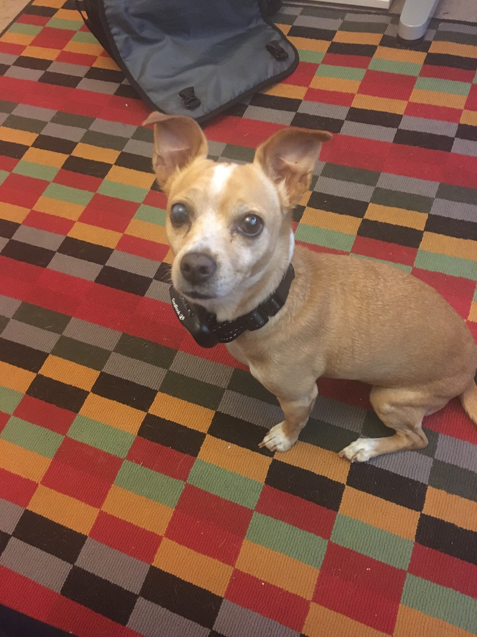
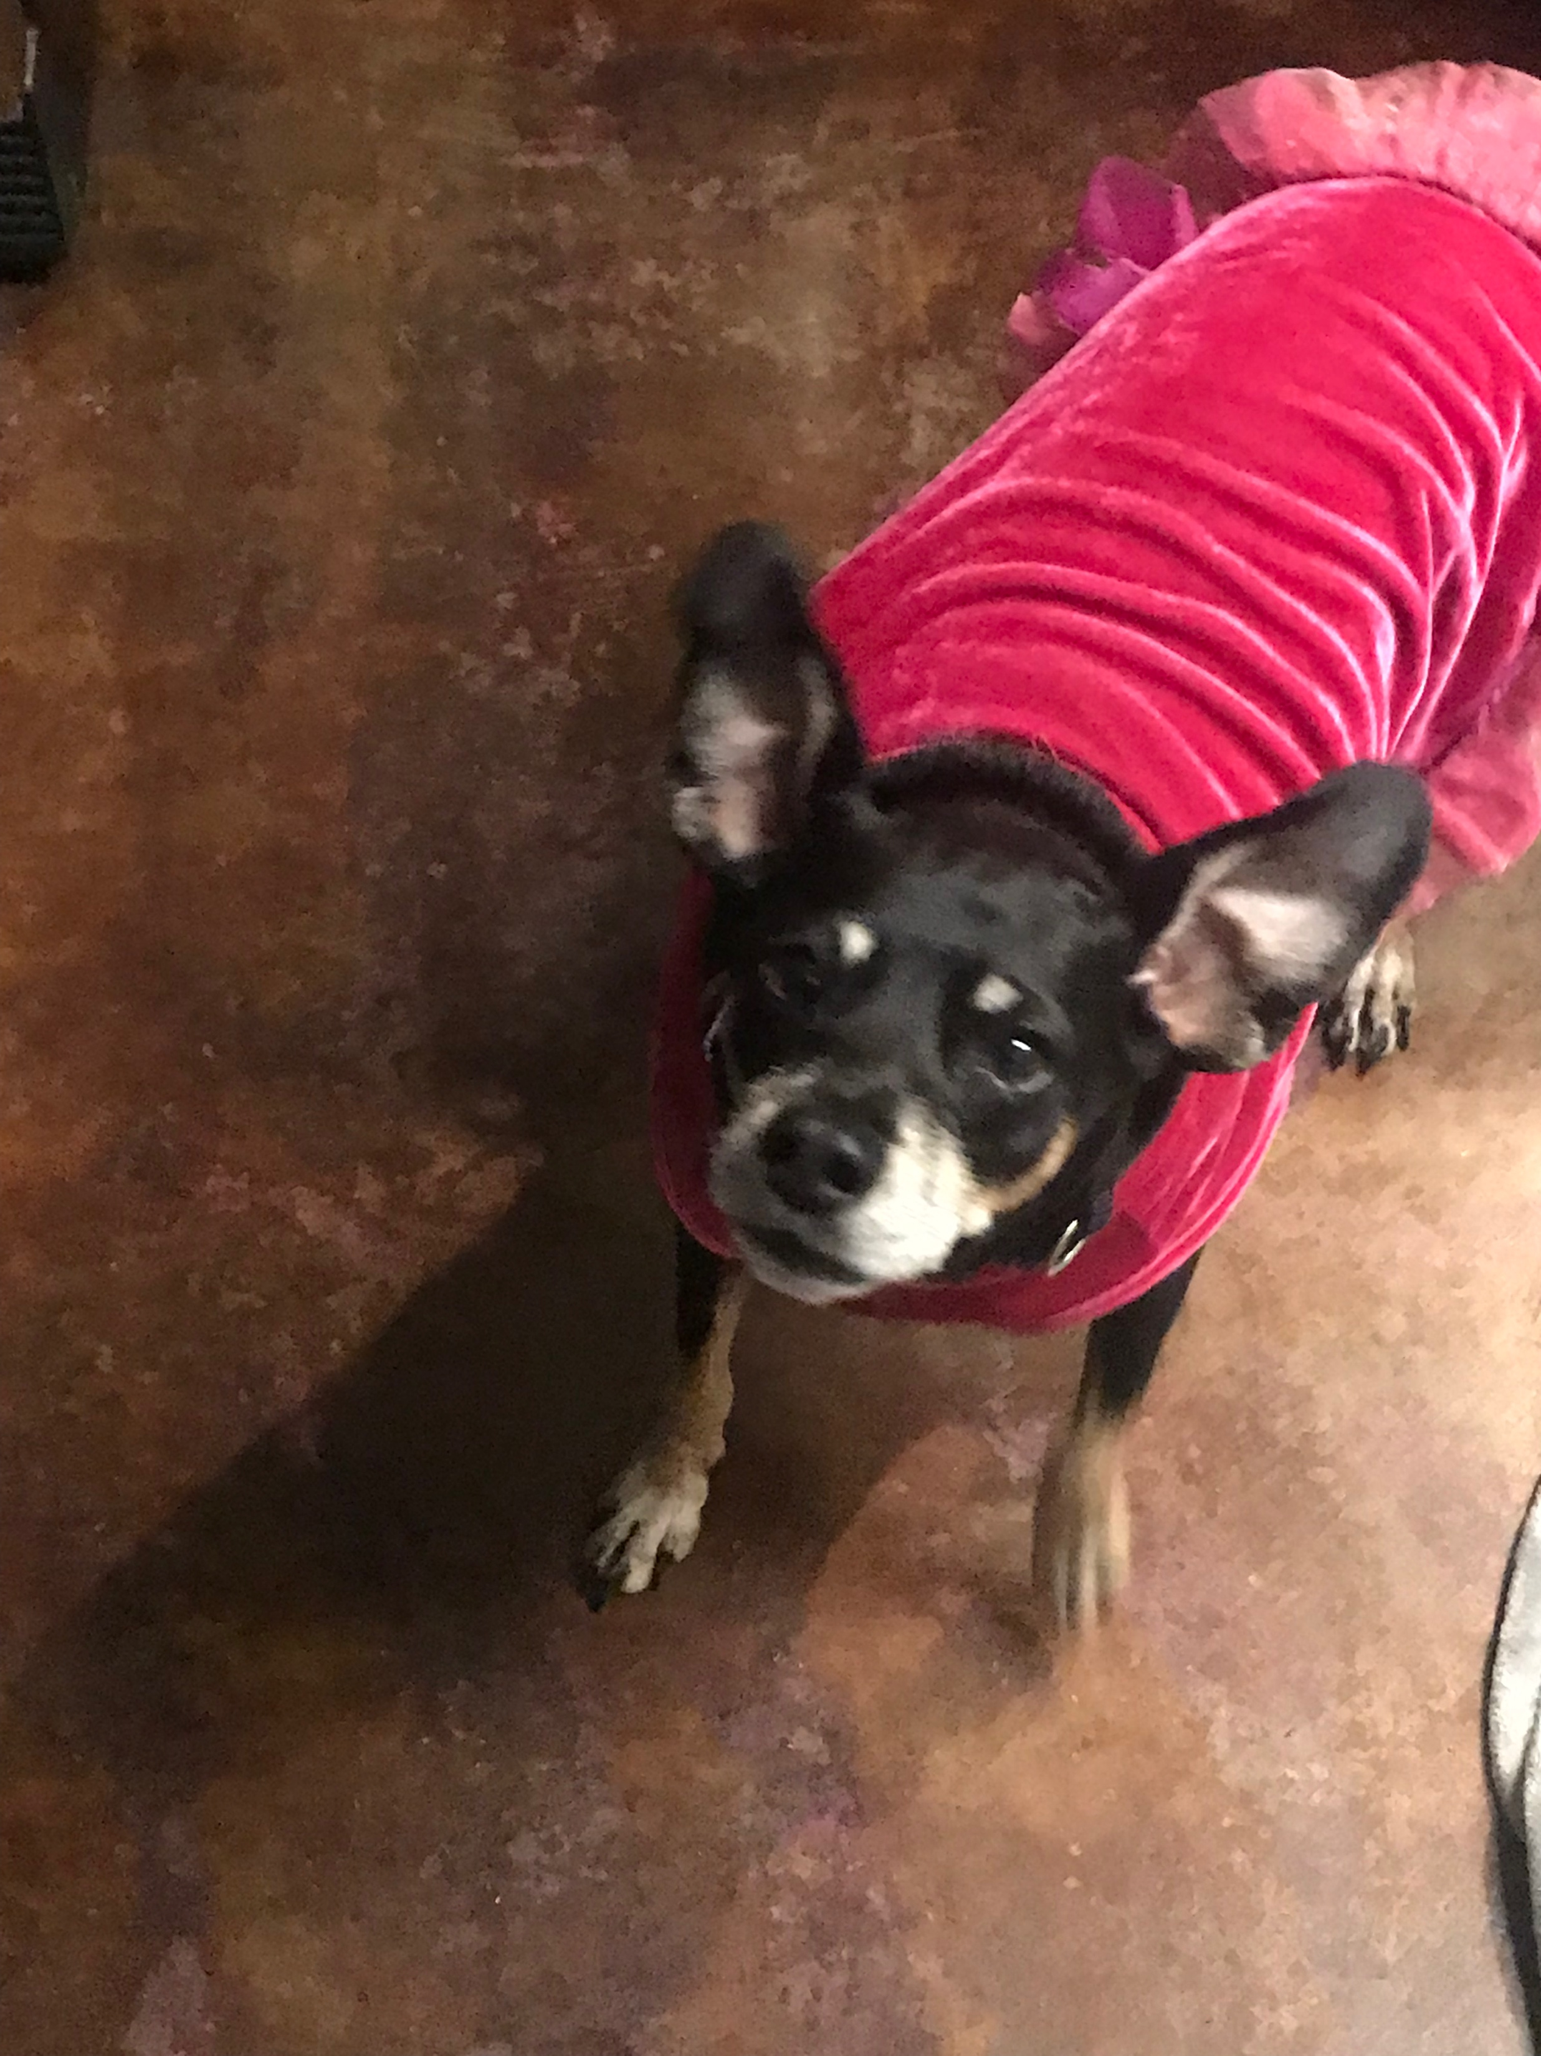
About me!
My name is Lillian Sutton, you may call me Ms. Sutton. I graduated ASU with my Bachelors in Art Education and Painting. I also have a degree in studio art, which is photography, ceramics, sculpture, drawing, and painting.
My personal artwork usually involves nature of some sort, i.e. plants and human anatomy.
I have two dogs Gidget and D. Rose (Named after the basketball player because they both have bum knees)
While I am way from school I am usually found researching human behavior and traveling. I am earning my Masters degree in Sociology and hopefully one day I will have my Ph.D. in human development.
I am originally from New York, so if at times I talk to fast or seem to want you to move a bit faster its because of my upbringing. Please let me know if you didn’t understand something I said.
I have a Senior Capstone, so this year I will be here early and leave late to help them but also you.

