Slide 1
Impressionism
Drawing with oil pastels.

Slide 2
Impressionism
When: Impressionism is an art movement that started in 1860 or the 19th century.
What: Impressionism is an art movement that was developed by Parisian artist to help show how important capturing light in a setting is. The idea then is to create art that has been impacted by light in a setting and capture it in that moment.
Who: Some artist that have played a role in creating this form of art are Edgard Degas, Claude Monet, Edouard Manet, Paul Cezanne, and Mary Casatt. https://youtu.be/kuOonogw-TM

Slide 3
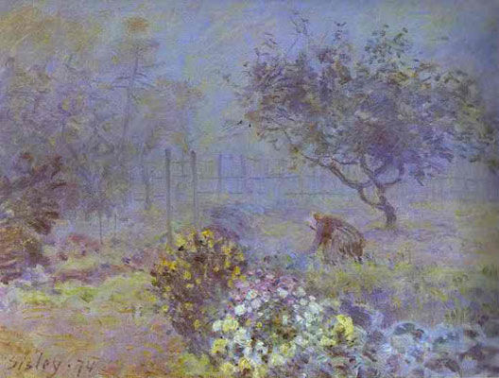
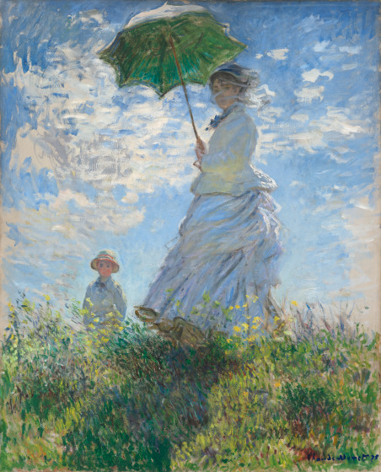
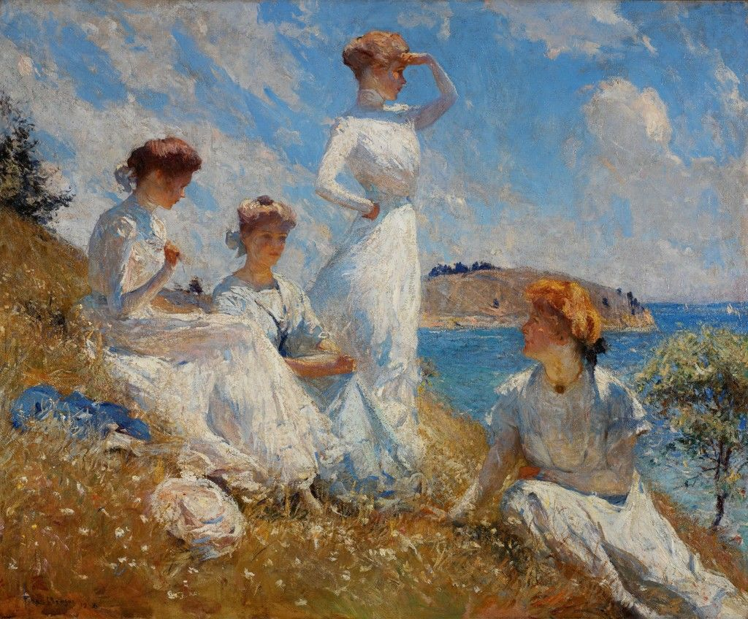
Examples of Impressionism

Slide 4
Important Assignment notes
With this assignment we want to work on using color to help us to define the image. This means we are using mostly color to create shapes and to create the image. We will be exploring using oil pastels and chalk pastels. (This might be something some students will want to keep using others might really not like it, we are learning how to use both so that you can explore the material. After this assignment you will not be required to use them again but you are required for this one assignment.)
Students are asked to use a color photo of their Cambridge topic (hint the one you made a mind map of) to investigate their image and recreate it like an Impressionist would.
This assignment is Due October 26th 2018 for full points. Photographs need to be uploaded to the google drive by Sunday October 14th at 8:00pm.

Slide 5
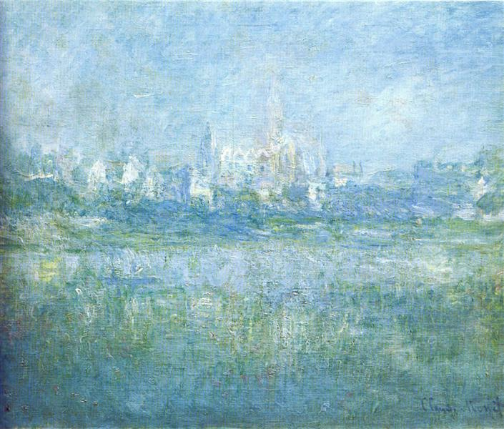
Creating an Impressionism Artwork
Impressionism is about capturing an impression of light, this means you are using the light, or the color of a photograph to create your drawing.
Look at the color in this picture and write down the images you see.

Slide 6
Cont.
From the image we just discussed you can see different colors building up to create a building over looking a body of water. This isn’t very defined, but we get the impression and the feeling of cool temperatures because of the colors used.
In your own drawings we will create images that give the feeling of what is happening in your photograph but not clearly defined images because impressionism is about capturing the feeling of the setting and not necessarily a photographic image.
You will want to try chalk and oil pastels first before committing to one. You will see that they are a like but also very different textures.

Slide 7
Practicing with Chalk pastels
Chalk pastels are very bright colors that are also very dulled when over lapped. The material itself is soft and easily blended. We will have to spray our work so that it stays on our drawing paper.
You will see that they blend really well but some students prefer to use paper towels so they do not smudge what they just added to the paper.
If the texture or having your fingers dirty isn’t something you like you do not have to use it for your impressionism drawing.

Slide 8
Practicing with Oil Pastels
Oil pastels are like crayons, but stick to the paper better and are blend-able. Oil pastels are like paint that you can draw with.
We use the oil pastels with baby oil or dry with blending tools to over lap and create textures in our drawings. Unlike the chalk oil pastels are not soft and will stay on the paper with out spraying. Oil pastels can get very messy very quickly if you aren’t careful.

Slide 9
After Practicing
After practicing drawing with both, what do you think is something you would use for your drawing?
Things to think about before drawing: do you need to create a light outline of where things in your picture are?
What part do you think will be the hardest to create?
Tell me what you know, Tell me what you clarified.

